Slide 1
MoMo Talent 2024 Data Analytics Trainee
Case Study
Candidate name: PHAM DUC TOAN
Candidate password: mt208jcrt0
Date: 12/06/2024

Slide 2
Part A: Data Processing
(10 points)

Slide 3
Part A
Question | Answer | Excel file data location (sheet/cell)
1) Total revenue in January 2020: | 53,814,234 VNĐ | PartA-Answer/B4
2) Most profitable month: | June | PartA-Answer/A21
3) Day of week (most money): | Wednesday 57,819 VND | PartA-Answer/B38
3) Day of week (least money): | Sunday 44,499 VND | PartA-Answer/B44
4) Total number of New users in Dec 2020: | 1303 | PartA-Answer/A51

Slide 4
Part B: Data Visualization
(10 points)

Slide 5
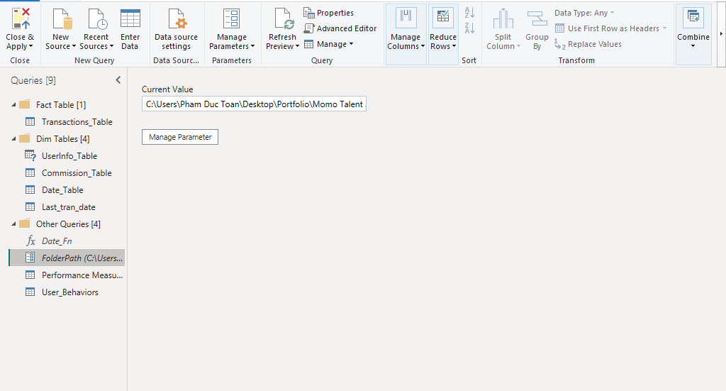
Part B: Q5: Performance Dashboard
Change the Folder Path Parameter
In order to reconnect to the data source, change the current value to the folder path where the dataset is stored

Slide 6
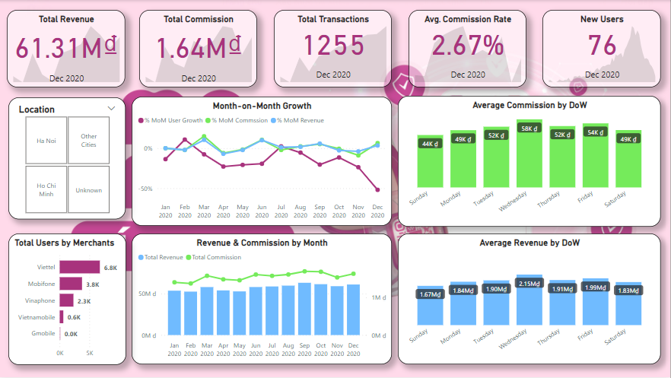
Part B: Q5: Performance Dashboard
Click on the monthly revenue & commission charts to filter Kpi cards
The KPI cards are depicting the metrics of the latest month only, click on the chart to view other months’ performance
Git Hub Repository:
https://github.com/TannerPham/Momo-Talent-2024

Slide 7
Part C: Analysis & Business Insights
(10 points)

Slide 8
Part C: Q6
Demographics (The 2nd Report Page of the Performance Dashboard)
The proportion of male and female customers are roughly 58% and 42% respectively in terms of either the total number of users ever since or the total number of active users (who has still used the service since November 2020)
The percentage of Ho Chi Minh-based active users has decreased by about 5% compared to the total number of Ho Chi Minh users.
On the other hand, more customers from other cities have been recently active, and total active users coming other cities have made up nearly 60% of the total, increased by 7%.
With regard to the age distribution of the customers, the number of customers who did not provide their age accounts for nearly 19% which means that 1 in 5 customers is unknown in terms of age.
Apart from the unknown group, the age group of 23-27 seems to outnumber when it comes to the total users and the total active users
Another thing needs to be noted is that about 50% to 55% of our customer base is under the age of 32; however, this might not be true due to the large percentage of age-unknown customers

Slide 9
Part C: Q6
Behaviors (The 3rd Report Page of the Performance Dashboard)
Customers are classified into 3 groups: Basic, Silver, Gold based on the monetary and frequency element in the RFM matrix:
+ Basic-level customers are the ones who have only made 1 purchase and their total order value is equal to 50 thousands.
+ Silver-level customers are the ones who have made 2 purchases and their total order value is above 50 thousands.
+ Gold-level customers are the ones who have made more than 2 purchases and their order value is above 300 thousands.
55% of total customers falls into the Basic category and about 44% is in the category of Silver. However, 80% of the total revenue comes from the Silver customers and only 19% is made up by Basic customers
There are only 18% of the total users who have been recently active since Nov 2022, and about 26% of customers who have not made any purchases for 2 to 4 months since 31st Dec 2020.
With regard to the purchase status, it is worth noting that average order value of top-up purchases that customers made for others is 2.7 time higher than when they bought for themselves.
Viewing the data from a ‘Day of Month’ timeframe, it can be seen that both the average revenue and average transaction volume has risen significantly in the 10th day and reached its peak in the 30th day of a month. Both these 2 metrics at the 30th day is about 220% higher than those at the lowest day.
-
-

Slide 10
Part C: Q7
Performance-improving Recommendations
Because the percentage of active-within-1-month customers is only 18%, there should be some kinds of top-up vouchers to remind the customers that have not used the top-up service for more than 2 months, mainly focus on the customers who are still active using other services but not using the top-up service so that It’s more likely to grab those customers’ attention.
Based on the user-behavior data, it can be seen that customers tends to spend 2.7 times more when they gift the top-up service to others. Therefore, there should be some recommendations of some other products like 4G mobile data to upsell the total order value especially when the customers are buying top-up for others.
On the high-demand days of a month such as 10th or 30th, more attractive discounts, vouchers or gift cards should be offered so that customers will keep using the service as their monthly habit. Besides, the customers should be recommended to top up their mobile credit on a certain day of a month so that the gross revenue is maintained and the volume of transactions are more predictable.
In terms of the age of customers, since there are up to 19% of customer whose age is not defined, the age range of our target audience might not be 100% accurate, there should be some kinds of incentives for the customers who has not filled in their age in the general information yet then they are motivated enough to do that and as a result, the age range of our target audience will be way more on-point.

Slide 11
Part C: Q8
Cashback Policy
From a perspective of a price-sensitive customer, it is for sure that this new cashback policy will motivate me to choose MoMo over other competitors when I want to top up my phone credit. The more money I get back from Momo, the more money I have to spend on anything that I want. However, I would use others’ top up services if they offer a better cashback rate without thinking twice.
From a view of a quality-oriented customer, service quality would be more important than the factor of pricing and refunds, saving a few thousands would not make any differences if all I am concerned about is the buying experience and the after-sales customer care service.
From a perspective of the Momo stakeholders, the increase of the cashback rate will might lead to surge of total revenue but it also negatively affect the profitability of the service which is not wanted by anyone who involves in Momo’s business.
Based on those 3 arguments that I have just made above, it is clear that the higher cashback rate is neither not going to affect the purchase decisions of all customers nor maintain the financial health of the company. Besides, the war of price has been proved to deeply cut the profit margin of the companies, have negative effects on the market, slowed down the business growth of every competitors in that market.
With that being said, I do not totally disagree on this change; however, the cashback rate should be tailored based on the customer’s total order value and buying frequency, which means that the more frequently they use the service and the more money they spend on each purchase, the higher the cashback rate will be.

Slide 12
Part C: Q9
Other Top-up Service development strategy
- The location of the customers should be considered when we develop a new plan to attract more customers and retain existing customers because each location have its own preferred merchants which should have a higher cashback rate or more discount offers than others so that the customers in that location are more motivated to use the services.
The cashback amount should not be transferred back to the current balance of the customers, they should be stored accumulatively in a virtual cashback account so that the customers can have their own choice to use the cashback in the next purchase or not. The customers will might like they have saved a lot of money when they buy a 20 thousand mobile top-up with 5 thousand from the cashback account and only 15k from their current account.
It is proved that the customers tends to spend more when they buy top-up services for others, and if the customers can send the top-up with some kind of short, warming messages to the receivers, it will make them feel better about themselves, when they are happy when they use the service, they will come back to the service because that how the rewarding mechanism in our brain works.

